Slide 1



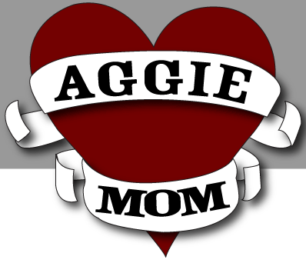
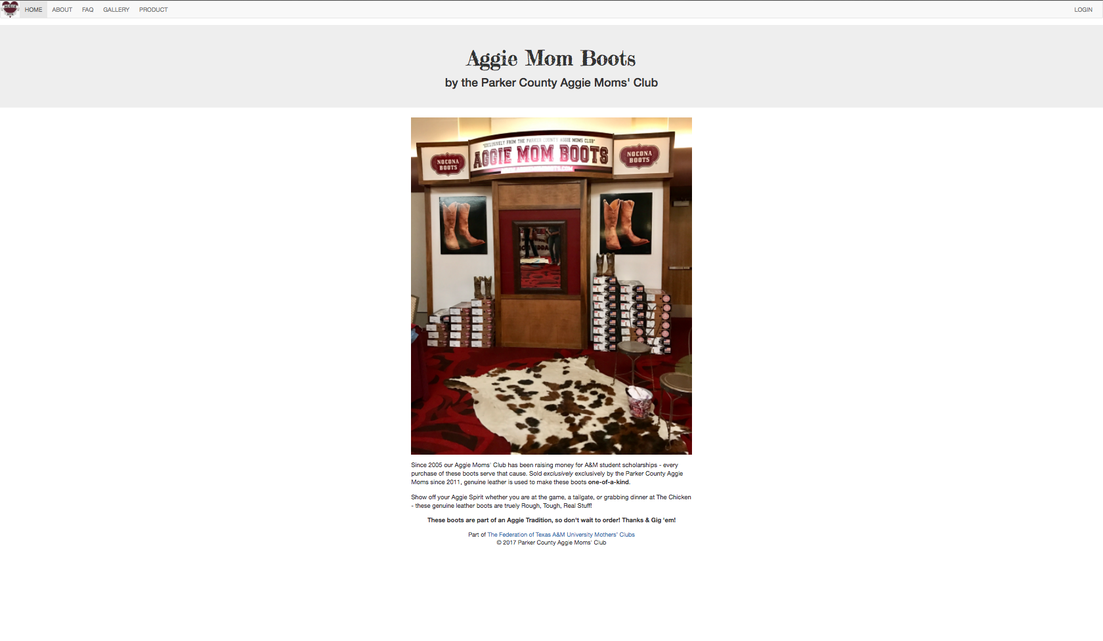
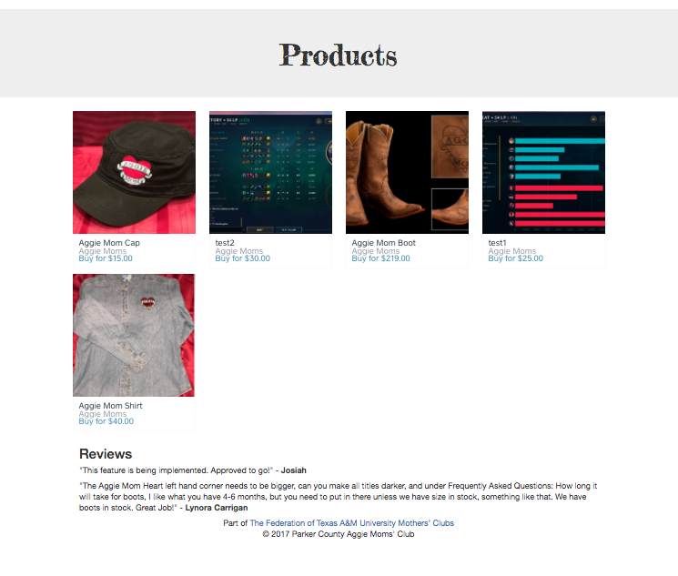
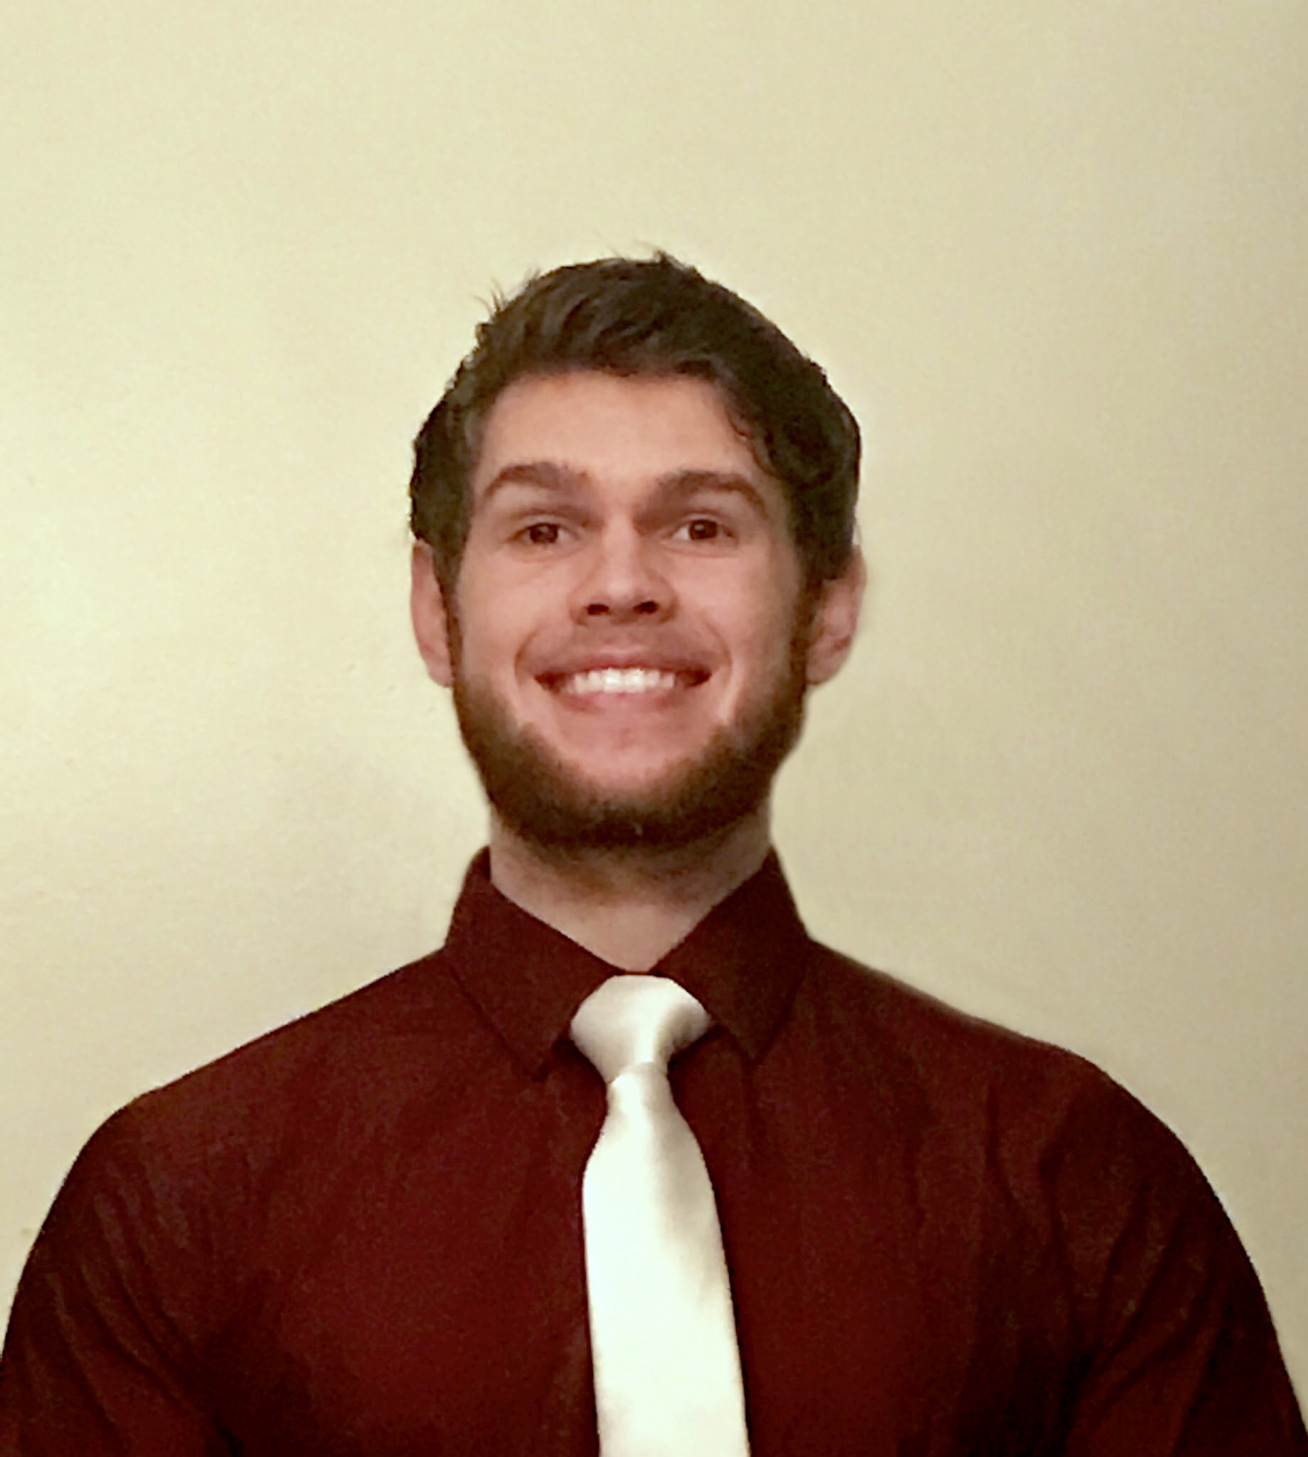
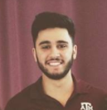



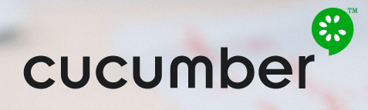
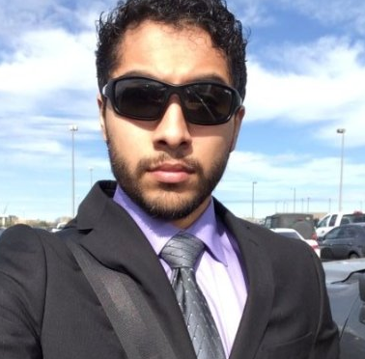
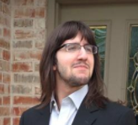





SaaS - Aggie Moms Boot Club
The reconstruction of Aggie Moms boot distribution website using Rails
Aggie Moms Club (Customer), Dr. Huang (Professor)
Landon Prewitt, Saifil Ali, Shawn Jafari, Josiah Egner, John Moreno
Abstract
Results
Aggie-mom-boots.herokuapp.com
As a SaaS team in Software Engineering, we were given the privilege of reconstructing the Aggie Mom Associations boot website! The previously existing site was outdated and too simple, containing one page of text and contact information. Our goal was to recreate it with better aesthetics, more functionality, and interactions.
Our final product consists of a rails app composed of 5 tabs, accessible in a toolbar at the top of the screen.
Home Page: This is the first page that loads when a user connects. A Picture with their setup is shown as well as some background information.
About Page: Here, the user can read more about Aggie moms Boot club. They’ll see what they do with their money (Scholarships), and a little about their products and organization that isn’t on the home page. There is also a link to their Facebook and emailing address at the top of the page.
FAQ: Here the website provides some general information regarding the products and shipping.
Gallery: The user can scroll through various pictures showcasing aggie moms and their products!
Products: Here the user can see a grid style view of all available products aggie moms boot club has for sale. The links will then redirect them to a square checkout page where the transaction occurs. Underneath this grid are customer review and notices available for all customers to see. These notifications are written by the administrator.
Administrator Portal: In the top left corner of the page, the owner can log in and apply notices for the website as well as manage which reviews are being displayed on the products page.
Objective
The objectives of this project pertain to two primary goals.
The first being to satisfy the customer. This entails establishing a strong communication with our customers to begin. From our communication with the customer, we were given specifics for the website to withhold, and then any additions can be added if desired. One of the features / requirements was for the website to at least provide information regarding the aggie moms club and aggie mom organization so that the customers can know more about them. Second, there should be a way for the customer to view what the products would look like and see what was available to purchase. Lastly and most importantly, the website must have some for of checkout so that the customers could purchase their products online using square, without having to create a purchase form through email / paper as they have been doing. The reason is because their method of creating forms to deal with purchases was a hustle and the most tedious part of their business.
The second goal was to learn about SaaS and software developing by having hands on experience throughout the entire process. Through this, we would learn the best approaches, and apply what was taught in the class to a real world project.
Approach and Process
Throughout the semester long project, we’ve approached the projects with a few styles of engagement. In the beginning, we’ve established a regular meeting time, being the lab times at 3:00 P.M. every Monday and Wednesday, Occasionally on Fridays depending on progress of each iteration. This approach deemed itself good enough throughout the entire duration of the project and never needed adjustment.
Programming – During the project, we did not discretely suggest paired programming, however we ended up using this strategy. Shawn and Josiah typically worked together on a lot of the project, Landon and Saifil worked as a pair implementing square checkout features and the product page. Josiah also ended up working on the products page with John Austin as a paired programming team. In comparison to our initial approach of everyone working on the project simultaneously in various areas, the paired programming seemed most effective and we used throughout the rest of the project timeline.
We’ve distributed the project into four iterations throughout the semester, ensuring that by each deadline, certain user stories and designs were complete with tests.
Iteration 1: Created the web application and configured development to Heroku. Familiarized ourselves with Ruby on Rails, including creating routes, views, and controllers. Created a basic template for the main page and the About page to test routes and page navigation, including navigation bar. Created cucumber tests for page changing.
Iteration 2: Created the static web content to have it approved by the client. Created routes and initial page content for main page, About page, FAQ page, and a placeholder for the Gallery page. Updated cucumber tests to include new pages that have been added.
Iteration 3: Integrated customer feedback on existing pages and created Gallery content. Began groundwork for online sale of boots.
Iteration 4: Finished online sale of boots (through Square API) and bugfixes.
The Team
Saifil Ali – Software Development (Front-end, Square Checkout)
Landon Prewitt – Software Development (Front-end, Square
Checkout, About Page)
Shawn Jafari – Scrum Master, Software Developer (Testing,
Pivotal Tracking, User Reviews, Login)
John Austin Moreno – Software Development (Gallery Page)
Josiah Egner – Team Leader, Software Dev, Communication
(Home page, Organized Meetings, Managed Repository)
Tools & Environments

